Slide 1
GEOLOCATION FINDER & MUSIC GENERATION

Slide 2
AGENDA
Previous Work
The Main Idea
Models
The Program
Expected Outcome
Code

Slide 3
PREVIOUS WORK

Slide 4
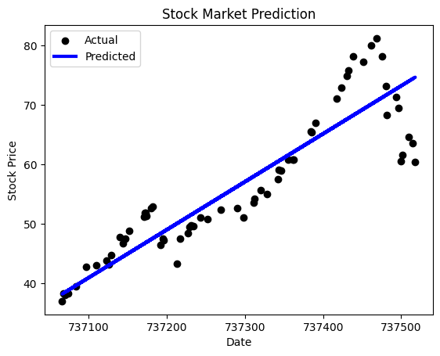
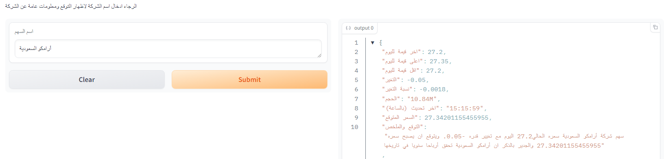
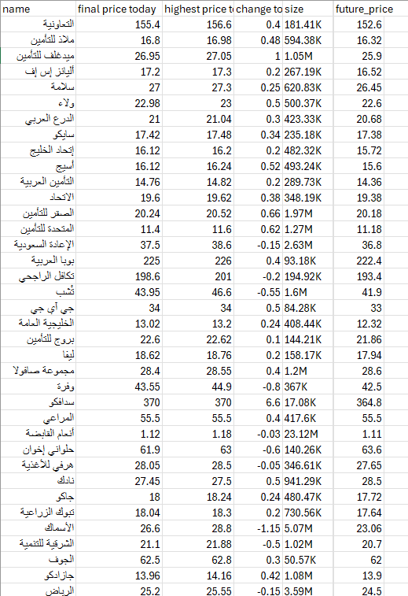
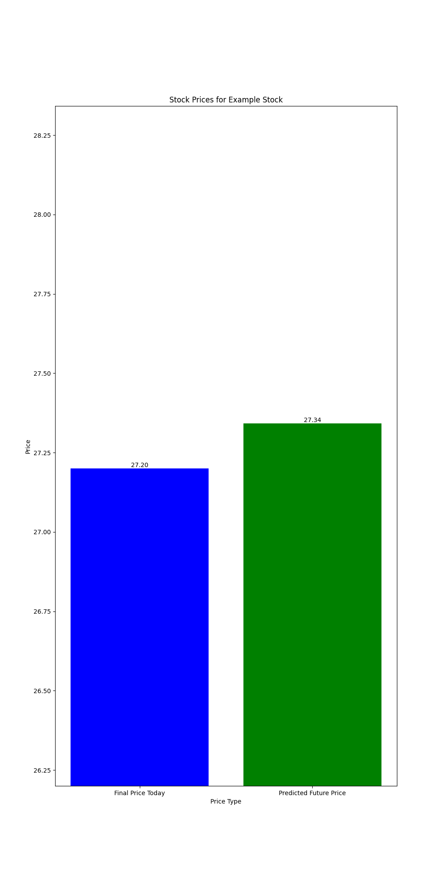
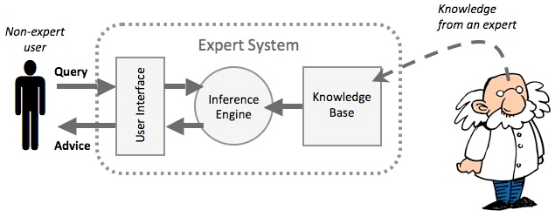
SAUDI STOCK MARKET PREDICTION
AI & STOCK MARKET PRESENTATION

Slide 5

THE MAIN IDEA
This program asks for an image of any place. Using Zero-Shot Image Classification, it guesses the country where the photo was taken. Additionally, it uses another pipeline to generate a short piece of music based on this country.

Slide 6
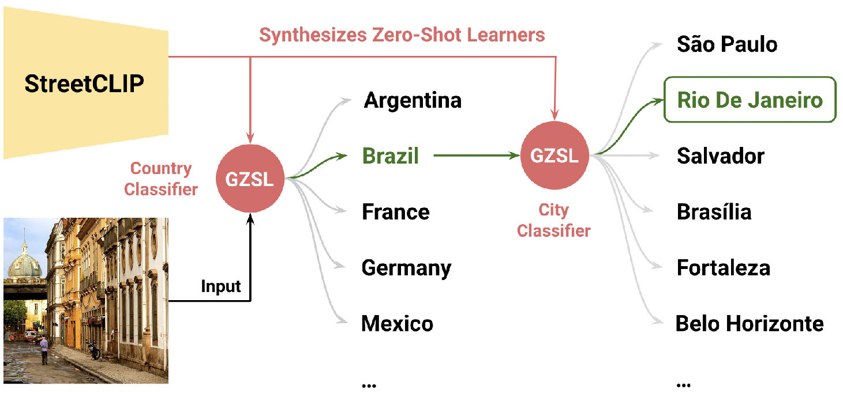
STREETCLIP
StreetCLIP, a robust, publicly available foundation model not only achieving state-of-the-art performance on multiple open-domain image geolocalization benchmarks but also doing so in a zero-shot setting, outperforming supervised models trained on more than 4 million images.

Slide 7
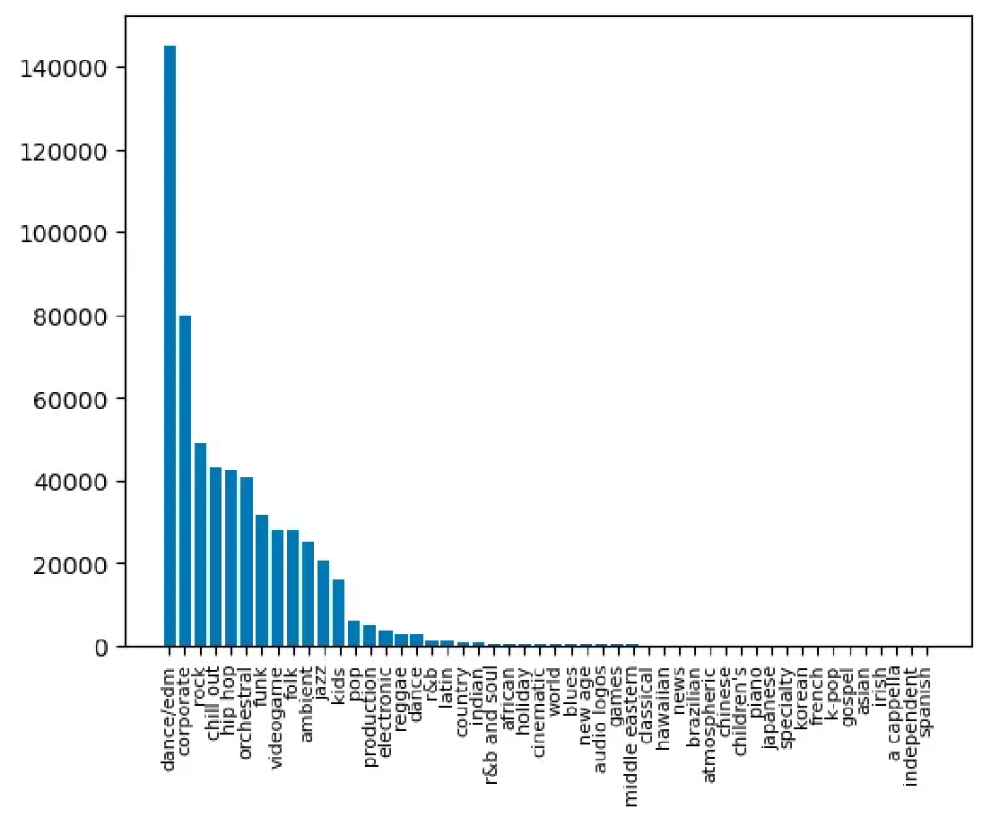
MUSICGEN
MusicGen is a text-to-music model capable of genreating high-quality music samples conditioned on text descriptions or audio prompts. It is a single stage auto-regressive Transformer model trained over a 32kHz EnCodec tokenizer with 4 codebooks sampled at 50 Hz.
Figure A.3: Histogram of the top 50 musical genres in the training dataset.

Slide 8
BILINGUALITY
Bilinguality in this pipeline is not needed since the only input is an image, but we can manipulate the output (country names) to be in two languages. Unfortunately, I did not have time to do this, but it will be added in a future update.
HUGGING FACE
Unfortunately, hugging face space cannot handle the music generation model. The only solution I found was to get the pro subscription, the other solution was to remove the music generation from the space.
I will try to find some other way but for now the hugging face space has only the geolocation finder

Slide 9
THE PROGRAM

Slide 10

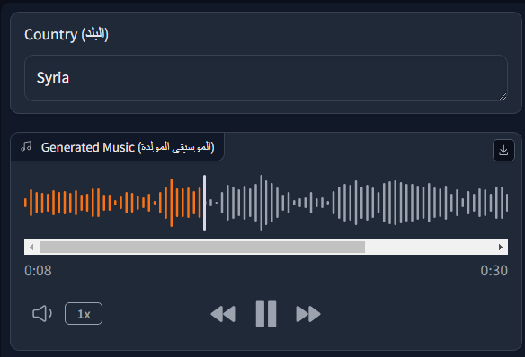
INPUT
OUTPUT
the input should be an image of any place.
The output should be the country which the image is from and a piece of music.

Slide 11

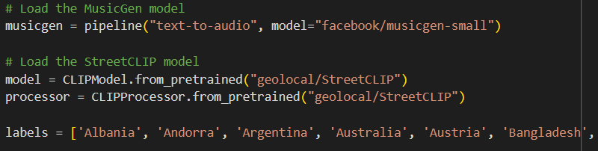
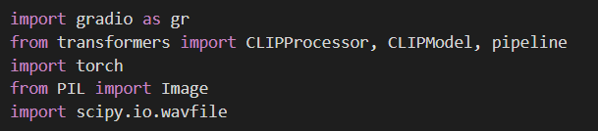
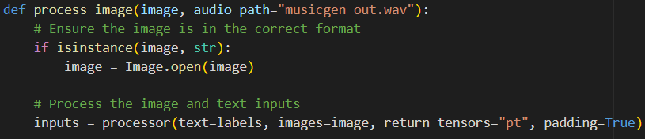
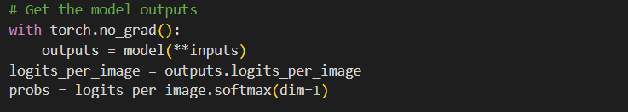

THE CODE (LOCATION FINDER)

Slide 12
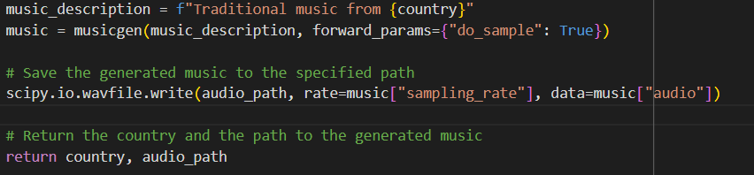
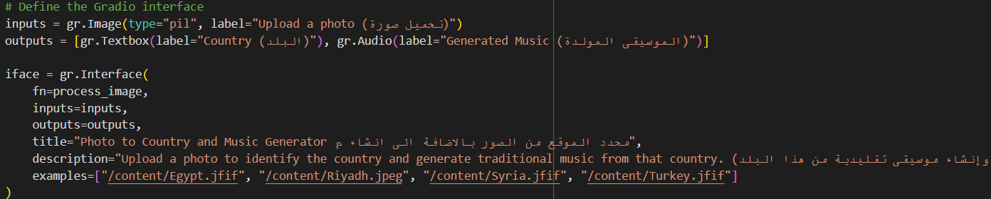
THE CODE (MUSIC GENERATION)

Slide 13
THANK YOU
hugging face link
https://huggingface.co/spaces/Faisal-Data/GeolocationFinder_MusicGenerator
Github Repository
https://github.com/Faisal-Data/Geolocation-Finder
Faisal Alghamdi

